Slide 1



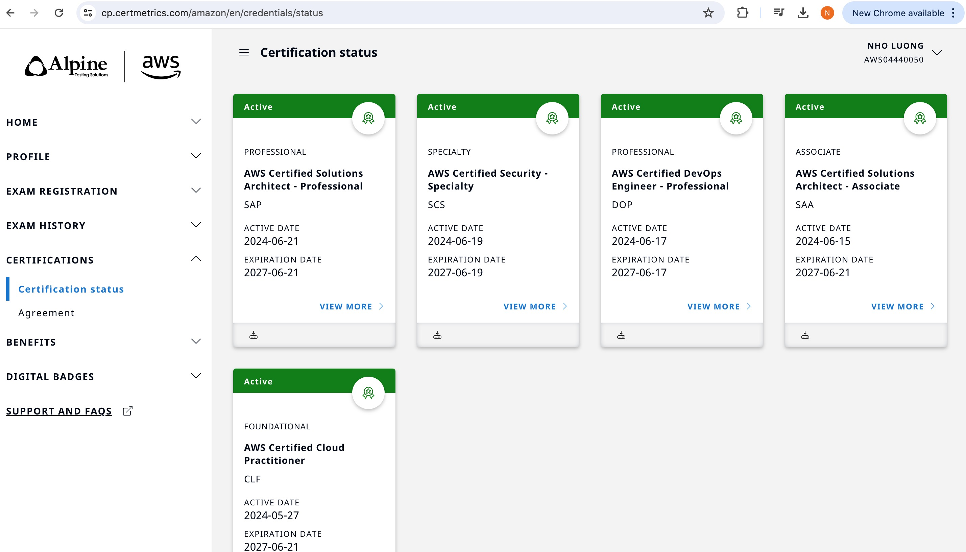
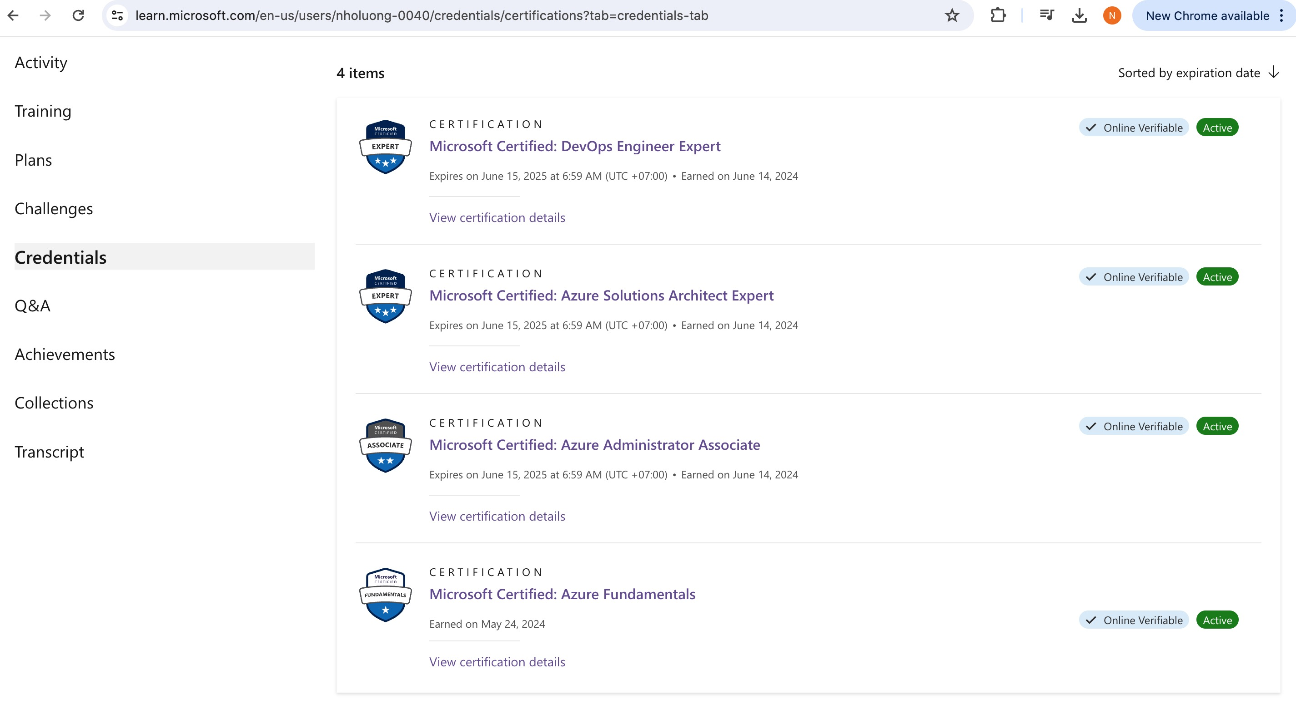
chef-client
Author: Nho Luong
Skill: DevOps Engineer Lead

Slide 2


chef-client
$ sudo chef-client --local-mode RECIPE_FILE
How would we apply both the workstation's setup recipe and apache's server recipe?
Author: Nho Luong
Skill: DevOps Engineer Lead

Slide 3
Objectives
After completing this module, you should be able to use chef-client to:
➢ ➢
Locally apply multiple cookbooks' recipes with chef-client. Include a recipe from within another recipe.
Author: Nho Luong
Skill: DevOps Engineer Lead

Slide 4

CONCEPT
--local-mode
chef-client's default mode attempts to contact a Chef Server and ask it for the recipes to run for the given node. We are overriding that behavior to have it work in a local mode.
Author: Nho Luong
Skill: DevOps Engineer Lead

Slide 5
CONCEPT
--run-list "recipe[COOKBOOK::RECIPE]"
In local mode, we need to provide a list of recipes to apply to the system. This is called a run list. A run list is an ordered collection of recipes to execute. Each recipe in the run list must be addressed with the format recipe[COOKBOOK::RECIPE].
Author: Nho Luong
Skill: DevOps Engineer Lead

Slide 6
Demo: Using 'chef-client' to Locally Apply Recipes
$ sudo chef-client --local-mode –r "recipe[workstation::setup]"
Applying the following recipes locally:
The 'setup' recipe from the 'workstation' cookbook
Author: Nho Luong
Skill: DevOps Engineer Lead

Slide 7
Demo: Using 'chef-client' to Locally Apply Recipes
$ sudo chef-client --local-mode -r "recipe[apache::server]"
Applying the following recipes locally:
The 'server' recipe from the 'apache' cookbook
Author: Nho Luong
Skill: DevOps Engineer Lead

Slide 8
Demo: Using 'chef-client' to Locally Apply Recipes
$ sudo chef-client --local-mode \
-r "recipe[workstation::setup],recipe[apache::server]"
Applying the following recipes locally:
• •
The 'setup' recipe from the 'workstation' cookbook The 'server' recipe from the 'apache' cookbook
Author: Nho Luong
Skill: DevOps Engineer Lead

Slide 9

Applying a Run List
Using a run list will allow us to specify things more 'logically' instead of with paths.
Objective:
❑
❑
Individually apply the apache cookbook's server recipe and workstation cookbook's setup recipe
Apply both the apache cookbook's server recipe and workstation cookbook's setup
recipe
Author: Nho Luong
Skill: DevOps Engineer Lead

Slide 10

GL: Return Home First
$ cd ~
LOCAL
Author: Nho Luong
Skill: DevOps Engineer Lead

Slide 11
GL: Apply the Cookbook Recipe Locally
$ sudo chef-client --local-mode -r "recipe[apache::server]"
[2016-09-15T14:54:45+00:00] WARN: No config file found or specified on command line, using command line options.
Starting Chef Client, version 12.3.0
resolving cookbooks for run list: ["apache::server"]
Synchronizing Cookbooks:
- apache
Compiling Cookbooks...
Converging 4 resources
Recipe: apache::server
* yum_package[httpd] action install (up to date)
* file[/var/www/html/index.html] action create (up to date)
* service[httpd] action enable (up to date)
LOCAL
Author: Nho Luong
Skill: DevOps Engineer Lead

Slide 12
GL: Apply the Cookbook Recipe Locally
$ sudo chef-client --local-mode -r "recipe[workstation::setup]"
[2016-09-15T15:15:26+00:00] WARN: No config file found or specified on command
line, using command line options.
Starting Chef Client, version 12.3.0
resolving cookbooks for run list: ["workstation::setup"]
Synchronizing Cookbooks:
- workstation (0.1.0)
Compiling Cookbooks...
Converging 4 resources
Recipe: workstation::setup
* yum_package[tree] action install (up to date)
* yum_package[git] action install (up to date)
* file[/etc/motd] action create (up to date)
LOCAL
Author: Nho Luong
Skill: DevOps Engineer Lead

Slide 13
Applying a Run List
Using a run list will allow us to specify things more 'logically' instead of with paths.
Objective:
✓
✓
Individually apply the apache cookbook's server recipe and workstation cookbook's setup recipe
Apply both the apache cookbook's server recipe and workstation cookbook's setup
recipe
Author: Nho Luong
Skill: DevOps Engineer Lead

Slide 14
GL: Apply Both Recipes Locally
$ sudo chef-client --local-mode \
-r "recipe[apache::server],recipe[workstation::setup]"
[2016-09-15T15:17:27+00:00] WARN: No config file found or specified on command line, using command line options.
Starting Chef Client, version 12.3.0
resolving cookbooks for run list: ["apache::server","workstation::setup"]
Synchronizing Cookbooks:
- apache
- workstation
Compiling Cookbooks...
Running handlers: [2016-09-15T15:17:30+00:00] ERROR: Running exception handlers Running handlers complete
LOCAL
Author: Nho Luong
Skill: DevOps Engineer Lead

Slide 15

Thank You
Author: Nho Luong
Skill: DevOps Engineer Lead

